Slide 1
ZØ: An Optimizing Distributing Zero-Knowledge Compiler
Matt Fredrikson University of Wisconsin | Ben Livshits Microsoft Research

Slide 2
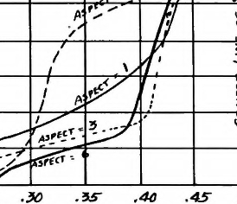


2
This talk: at a glance
Automatic Optimization
  Cost modeling enables huge optimization opportunities
Distributed Environments
  ZØ automatically places code on different computational tiers
“Zero-Knowledge for the Masses”
  Users write ZK code in C#, as one part of a larger project
Notes:
Begin with a high-level outline of the talk --- introducing the three main things Z0 has to offer
These will be the focus of the rest of the talk

Slide 3
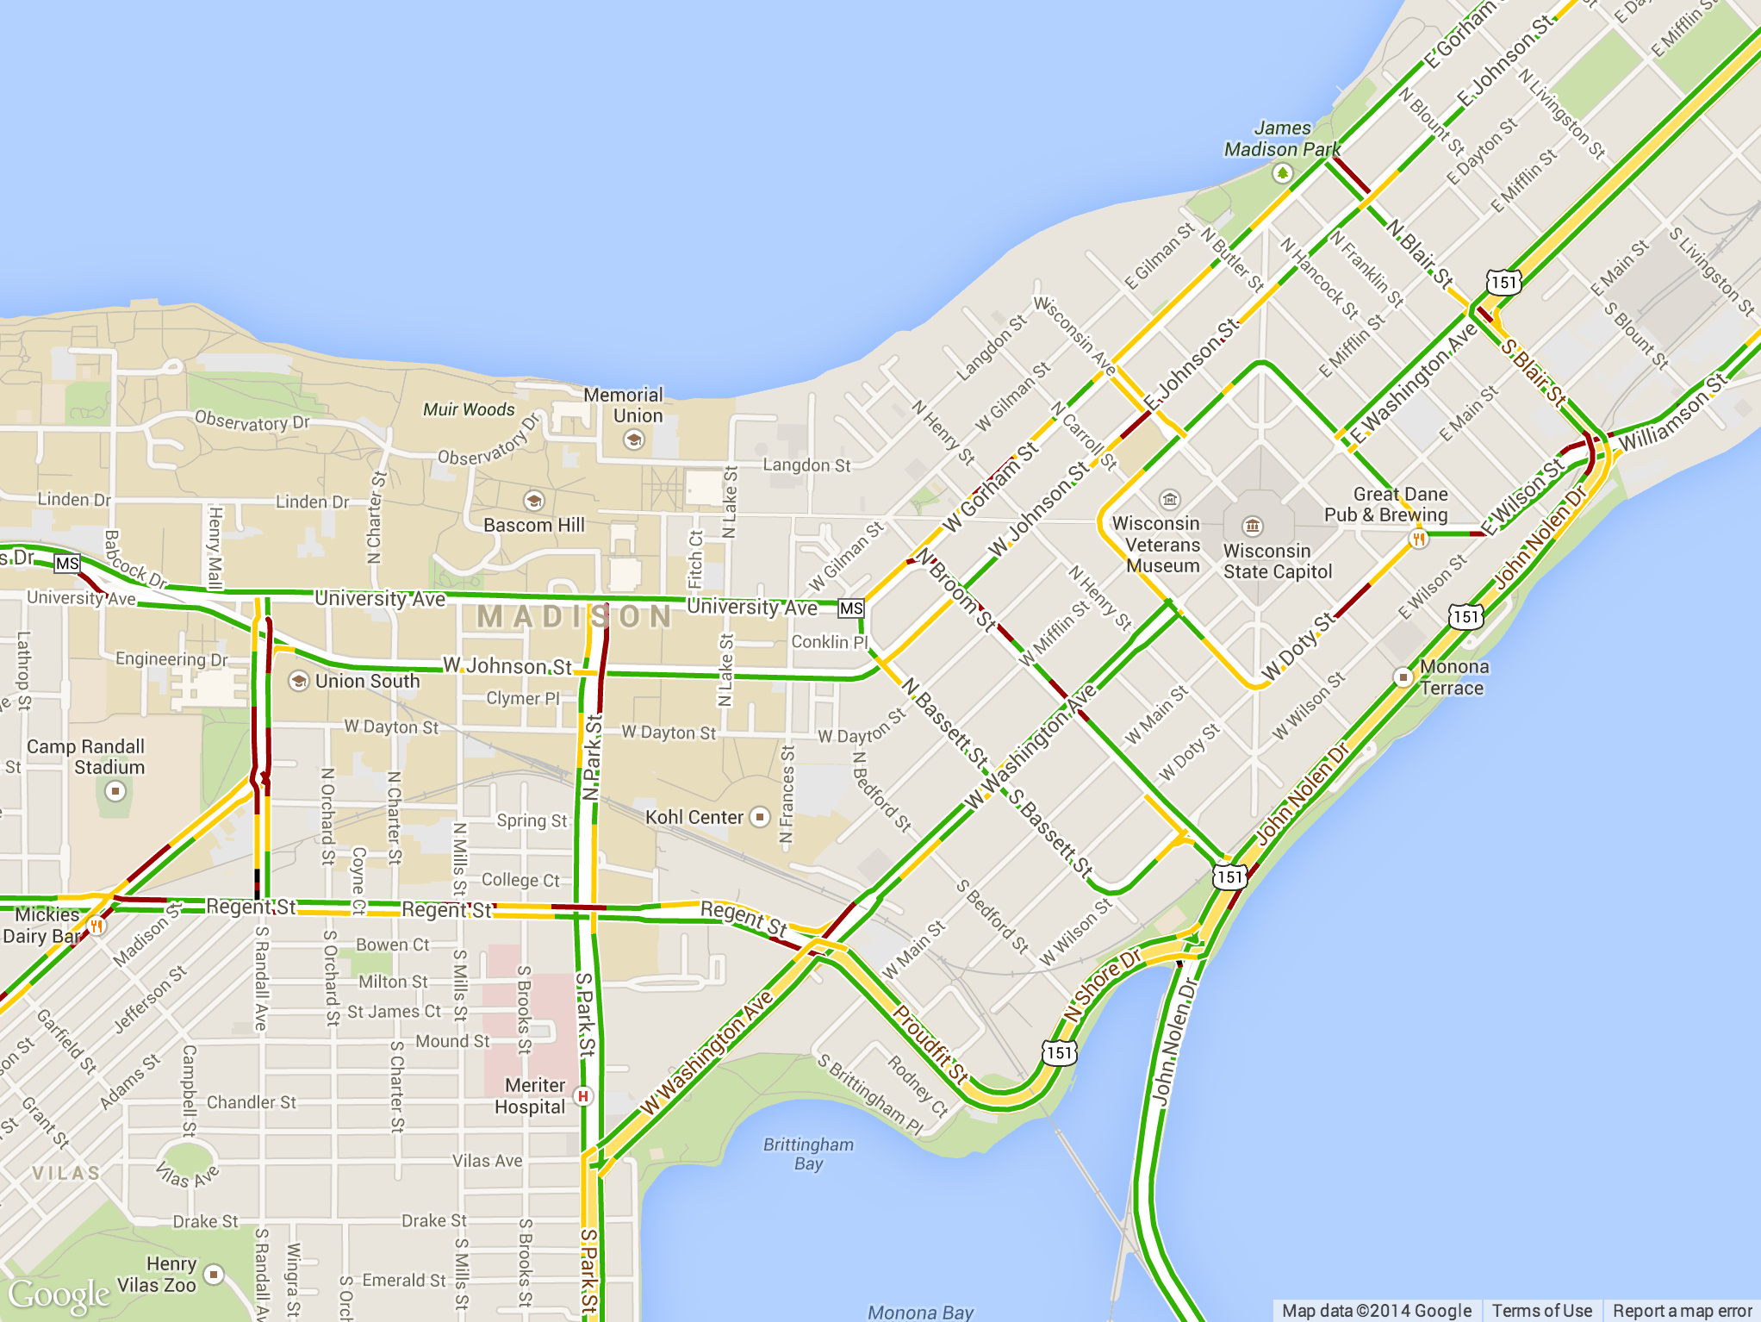



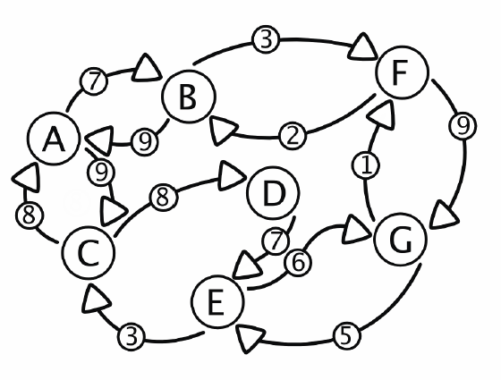

3
This talk: at a glance
Crowd-sourced traffic maps
Personal Fitness Rewards
Retail Loyalty Card
Human Subjects Studies
Collaborative Recommender
System
Collaborative NIDS
Notes:
Begin with a high-level outline of the talk --- introducing the three main things Z0 has to offer
These will be the focus of the rest of the talk

Slide 4
4
Crowd-sourced traffic maps
Notes:
Transition into waze overview by saying, “let’s take a closer look at one of these applications”
Change to google map

Slide 5

Notes:
After the high-level talk overview, take a step back and explain why we need ZK code

Slide 6


Location data
Integrity concern:
users send false data
to protect their location
Privacy concern:
server knows all my locations
Traffic Information
Notes:
Outline:
Show a diagram of the distributed architecture of Waze
Juxtapose two images of information flow: the current (non-private) implementation, and the private version that we target with our implementation

Slide 7
Location data
Integrity concern:
users send false data
to protect their location
Zero-knowledge proofs offer a solution to this fundamental tension
Privacy concern:
server knows all my locations
Traffic Information
Notes:
Outline:
Show a diagram of the distributed architecture of Waze
Juxtapose two images of information flow: the current (non-private) implementation, and the private version that we target with our implementation

Slide 8

“Opaque” Location data
Location data
Aggregate Traffic Data
+
zero-knowledge
proof
Traffic Information

Slide 9
Partition roads into segments
Use Shamir shares on segment IDs
Notes:
Explain how peers share “opaque” location data
Roads on the map are partitioned into segments
Peers find their segment ID
Then create a Shamir share from the ID to send to peers

Slide 10
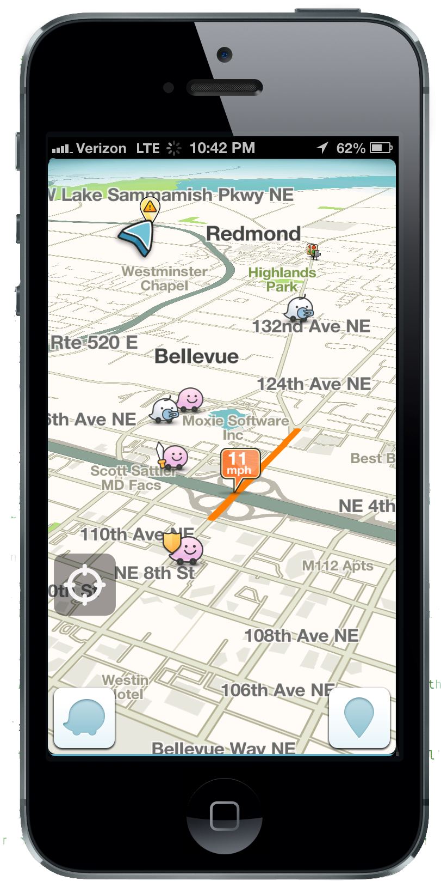
Initial Experiments
We implemented this core
functionality in zero-knowledge
ZQL
[Fournet et al.,
Usenix Security 2013]
Pinocchio
[Parno et al., Oakland 2013]
Notes:
We implemented this traffic stats app
In both ZQL and Pinocchio, as well as a “hybrid” solution
Here are the results
Replace graphic with waze screenshot
Scale this vertically
add citations

Slide 11
Why Such a Contrast?
These zero-knowledge “back-ends” have significantly different execution models
ZQL
Pinocchio
Compiles specialized language to F#, then CIL
Compiles C to a fixed circuit representation
Notes:
Outline:
Begin to explain why such a dramatic performance discrepancy exists
Discuss ZQL
Discuss its object code execution model
Briefly discuss how it translates a functional program into setup, prover, and verifier

Slide 12
ZØ: An Optimizing Compiler for ZK
12
ZØ uses the best of both back-ends as appropriate for the application at hand
Automatic Optimization
“Zero-Knowledge for the Masses”
Distributed Environments
Notes:
Point out the key technical insight
Remind users about the contributions, using familiar graphics from the first slide

Slide 13
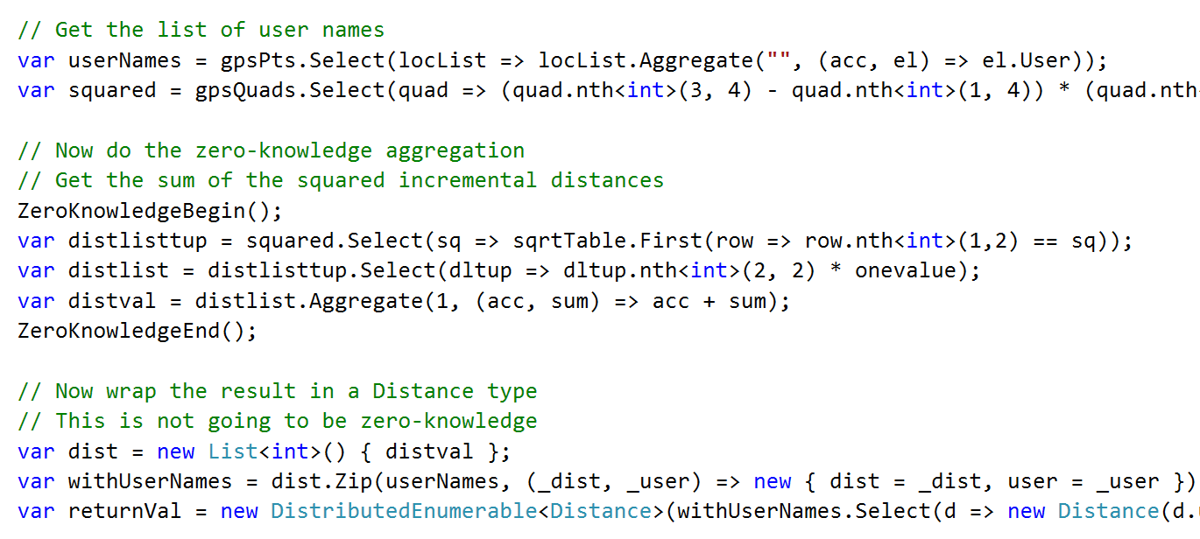
ZØ: An Optimizing Compiler for ZK
13
Input
Performance Analysis
ZK Translation
Tier Splitting
  Users write code in C#
Notes:
Give an overview of how the compiler accomplishes its goals

Slide 14
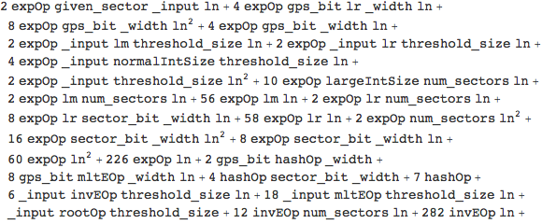
ZØ: An Optimizing Compiler for ZK
14
Input
Performance Analysis
ZK Translation
Tier Splitting
  Build detailed cost models that characterize how
  expensive C# will be when translated to zero-knowledge
System
Timings
Cost Model
Program Structure
Notes:
Give an overview of how the compiler accomplishes its goals

Slide 15
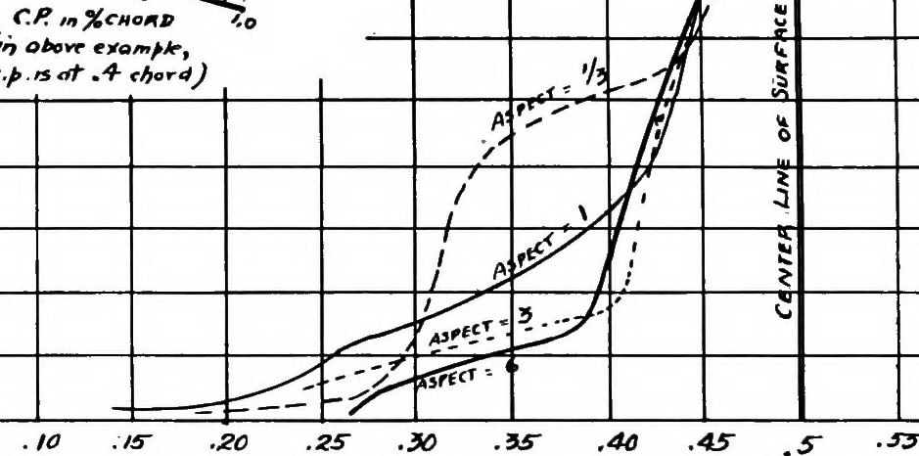
ZØ: An Optimizing Compiler for ZK
15
Input
Performance Analysis
ZK Translation
Tier Splitting
  Use cost models to find optimal translation,
  then convert to ZK-producing IL
Cost Models
Global Optimization
.NET IL
Performance Profile
Notes:
Explain performance profile as follows: “the programmer might specify, for example, that compute cycles are at a premium for the mobile front-end”

Slide 16

ZØ: An Optimizing Compiler for ZK
16
Input
Performance Analysis
ZK Translation
Tier Splitting
  Use location annotations to split IL between tiers,
  insert automatic data transfer and synchronization
Compiled
IL
Final Output
Tier 1
Pinocchio
ZQL
Location Annotations
Automatic Marshaling
Tier 2
ZQL
ZQL
ZQL
Notes:
Give an overview of how the compiler accomplishes its goals

Slide 17
ZERO-KNOWLEDGE IN C#

Slide 18
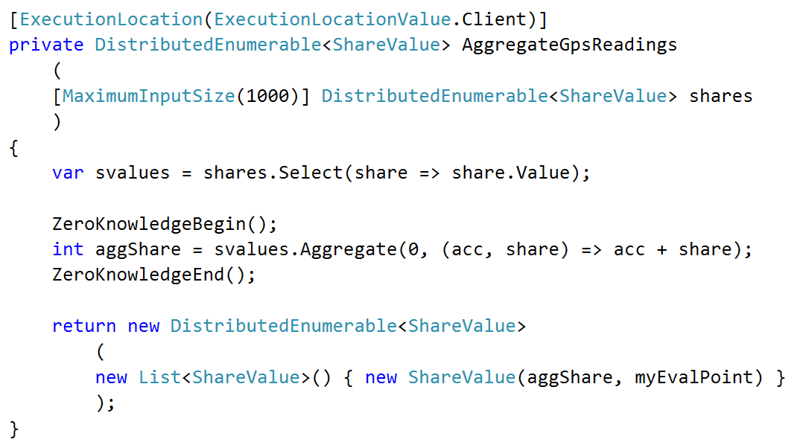
Zero-Knowledge in C#
Location annotations drive tier-splitting
Specify ZK input sizes to help optimization
Programmers specify ZK regions
ZK operations given by LINQ expressions

Slide 19
COST MODELING

Slide 20
Cost Models for Optimization
Cost models characterize the ZK runtime of C# code
  C# Source
  Size of Input
Cost Model
  Runtime
  Micro-op timings
F(inputListSize) = eqOp * inputListSize + addOp + 12*expOp + 3 * extendOp + 14*mltOp
size of input
micro-op timings
Notes:
What is a cost model?
Answer this question with the diagram
Gray out previous parts

Slide 21
Building a Cost Model
Symbolic evaluation over polynomial domain
Static circuit evaluation polynomials
ZQL
Pinocchio
map, fold, find expressions: we can always bound the number of ops in each expression
Given a circuit, we can determine evaluation and proof generation time
Notes:
Outline:
Discuss the key insight that allows Z0 to select the appropriate back-end for each statement
Zero-knowledge computations necessarily have bounded computation time
We can build detailed performance models that characterize the number of operations required to produce and verify each zero-knowledge proof
These models amount to polynomials over the expected input size to each computation

Slide 22
TRANSLATION &
TIER SPLITTING

Slide 23
Translating C# to Zero-Knowledge
  Cost Models
  Performance Profile
f(inputListSize) = eqOp * inputListSize + addOp + …
Tier
Compute Cost
Transfer Cost
f(numPeers) = addOp * numPeers + multOp + …
Mobile
2
3
Server
0.5
1
f(numItems) = multOp * numItems + eqOp + …
…
…
…
  Global Optimization
  .NET IL
Pinocchio
ZQL
ZQL
Pinocchio
ZQL

Slide 24
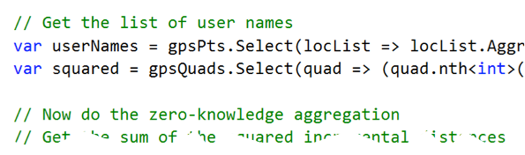
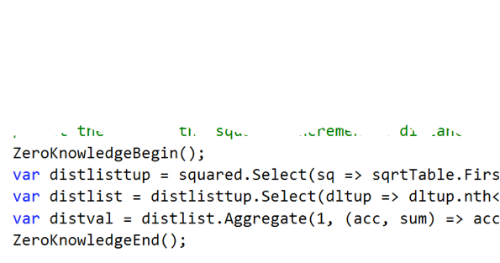
Insert code for marshaling and synchronization
Aggregate Traffic Data
Traffic Information

Slide 25
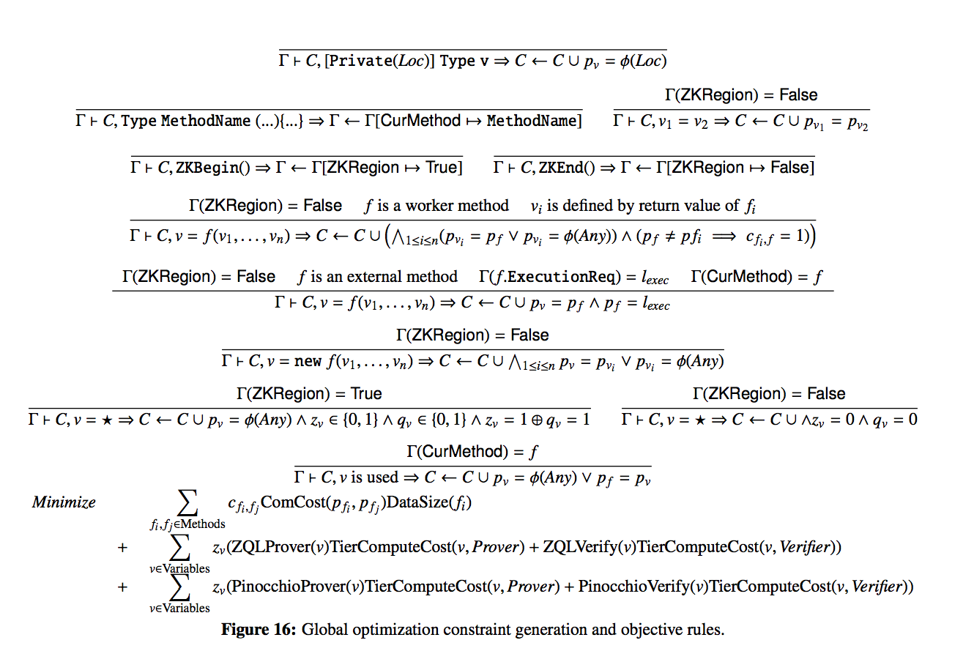
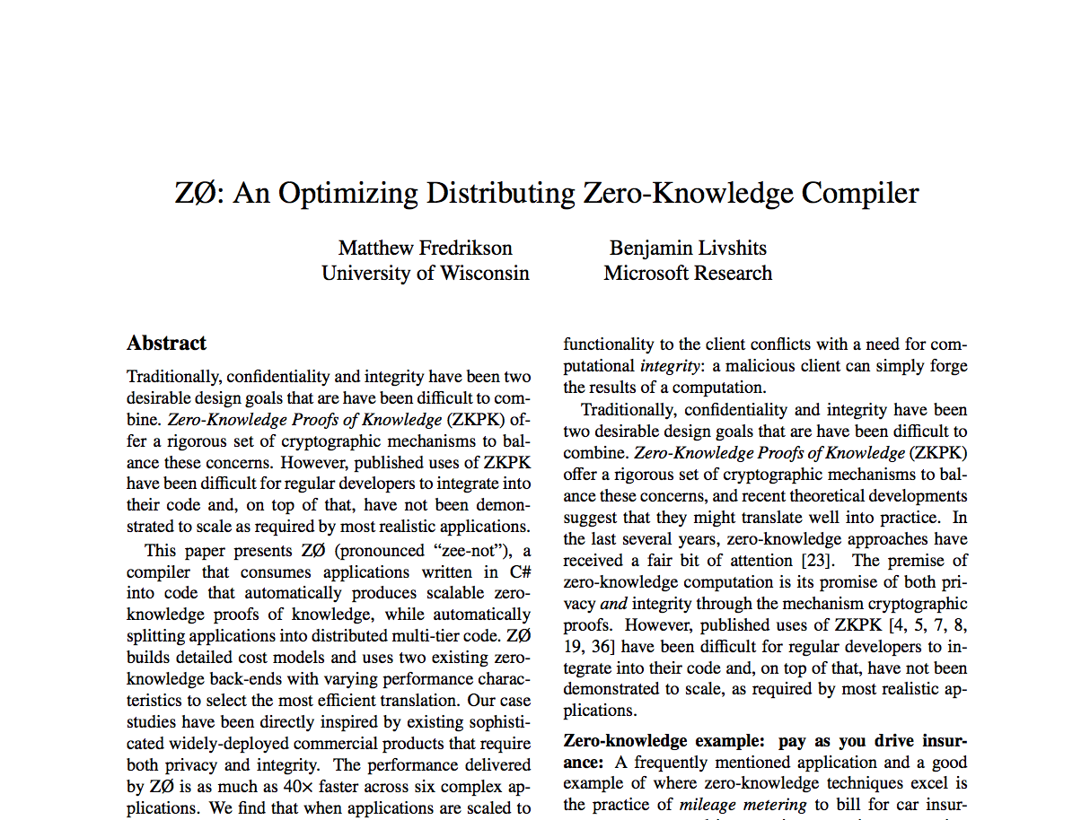
Translating C# To Zero-Knowledge
Notes:
Just say, “we have some formal rules for translating LINQ to expressions used by the back-ends, but I won’t detail them today. See the paper.”

Slide 26
Evaluation

Slide 27
Experiments
We ran each application in three configurations
ZQL
Pinocchio
ZØ
Crowd-sourced traffic maps
Personal Fitness Rewards
Retail Loyalty Card
Human Subjects Studies
Collaborative Recommender
Collaborative NIDS

Slide 28
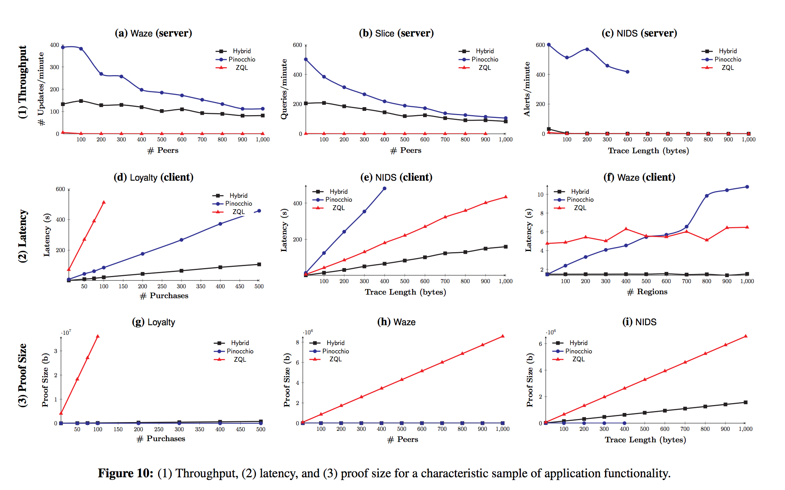
Experiments
We ran each application in three configurations
ZQL
Pinocchio
Hybrid

Slide 29
Loyalty Application, Client’s Time to Process Transaction
ZQL times out on longer transactions
ZØ
ZØ’s cost models identified expensive operation, used correct back-end
Expensive operation on a hot path
More gradual
linear scaling
Notes:
Outline:
Show results from Waze: scaling behavior in # clients and # regions

Slide 30
NIDS Application, Server’s Throughput
ZØ
Global optimization traded server performance on small inputs for greater scalability on both tiers
Pinocchio’s throughput is much higher!
Client configuration times out
Notes:
Outline:
Show results from Waze: scaling behavior in # clients and # regions

Slide 31
Experiments
We ran each application in three configurations
ZQL
Pinocchio
ZØ
Scaling
  Scales up to 10x larger data
Performance
  Up to 40x improvement in runtime
Proof Size
  Up to 10-100x smaller than ZQL

Slide 32
Conclusions
Cost modeling enables aggressive optimizations
High-level input language brings ZK “to the masses”
Automatic tier splitting simplifies distributed apps
Illustrated benefits with six applications

Slide 33

Backup Slides
Notes:
Thank the audience, give acknowledgements to everyone who helped us.

Slide 34
34
This talk: at a glance
Crowd-sourced traffic maps
Personal Fitness Rewards
Crowd-sourced traffic maps
Personal Fitness Rewards
Retail Loyalty Card
Retail Loyalty Card
Human Subjects Studies
Human Subjects Studies
Collaborative Recommender
System
Collaborative Recommender
System
Collaborative NIDS
Collaborative NIDS
Notes:
Begin with a high-level outline of the talk --- introducing the three main things Z0 has to offer
These will be the focus of the rest of the talk

Slide 35
Thanks!
Conclusions
ZØ is a new zero-knowledge compiler
  Detailed cost modeling enable aggressive optimizations
  High-level language brings ZK “to the masses”
  Automatic tier splitting simplifies distributed apps
Illustrated benefits with six interesting apps
  ZØ’s optimizations make these feasible
Notes:
Thank the audience, give acknowledgements to everyone who helped us.

Slide 36



Modern apps demand personal data
Often the need for data is legitimate
Pressure to address privacy concerns is widespread
In many applications, this creates a tension between privacy and integrity
Notes:
After the high-level talk overview, take a step back and explain why we need ZK code

Slide 37
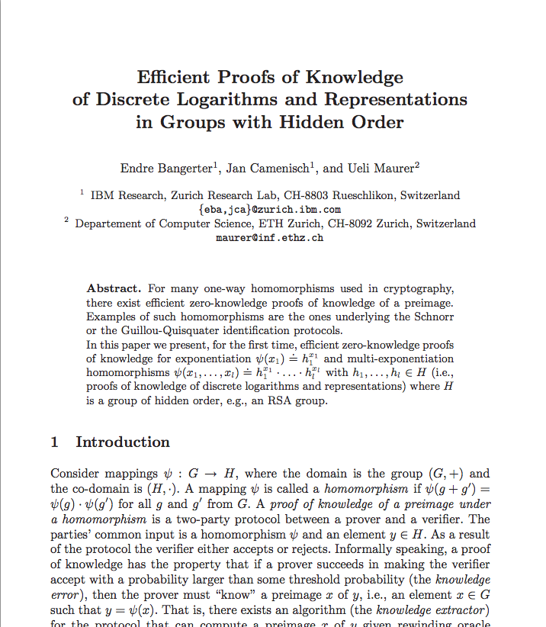
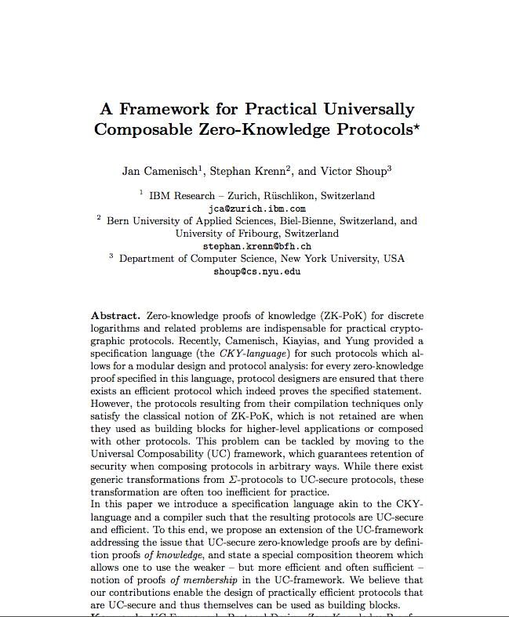
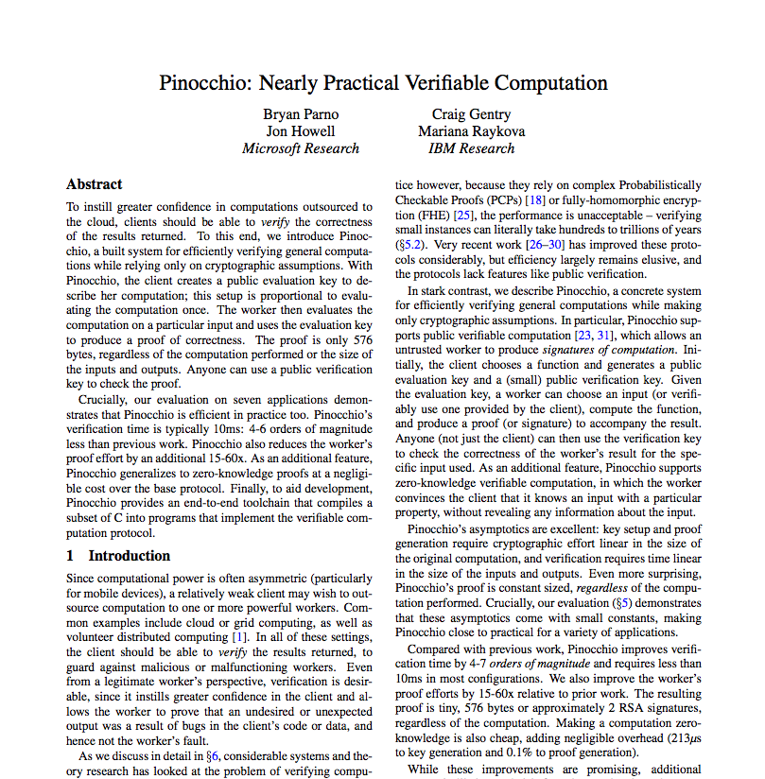
Zero-Knowledge: A Promising Solution
Lots of theory…
But very little practice…
Prove that a computation was performed
correctly without revealing inputs
?
Privacy
Integrity
Notes:
Outline:
Talk about zero-knowledge proofs of knowledge as a solution to the privacy/integrity tension
Introduce the main problem addressed by our work: zero knowledge has not been scaled to the level required by real-world applications

Slide 38
The map is broken into regions, and the desired statistic is the number of clients in each region at time t.
At regular intervals, the server requests density stats from the clients.
On receiving a request, each client:
  Takes a GPS reading
  Computes its map region
  Encodes its region as a vector, zero everywhere but the column for its region
  Creates shares of its vector, sends them to other clients
  On receiving the other clients’ shares, each client sums all received shares and sends the result to the server
On receiving the summed shares from the clients, the server reconstructs the sum to obtain the density map
Zero-Knowledge
Notes:
Outline:
Show pseudocode for our implementation of private Waze
Discuss how privacy and integrity are accomplished
Show which sections require zero-knowledge

Slide 39

Customer Loyalty App
Scan at checkout to receive discounts
Discounts are based on customer’s previous transactions
Examples: Walgreens’ iPhone app, Safeway “just for U”
Pinocchio Verifier Crashed
Privacy Concern: Merchant tracks all of my purchases
Integrity Concern: Customer might target specific discounts by faking history
Our Solution: Implement “discounter” as transducer over purchase history, only send transducer output to merchant.

Slide 40


Personal Fitness Rewards
Reads workout data from personal training device (FitBit, Garmin, …)
Users receive points for each mile walked, run, biked…
Points can be applied to charities, or redeemed for discounts and rewards
Privacy Concern: Sending my location data to a third party
Integrity Concern: Users lie about their exercise to receive free goods
Our Solution: Compute distance from GPS coordinates on the user’s computer, send final result to third party

Slide 41
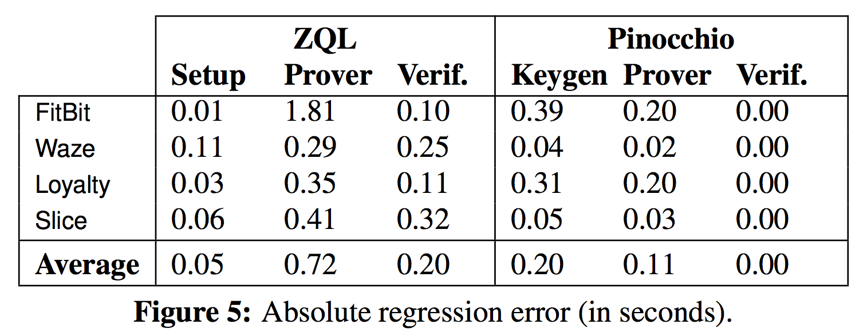
Cost Model Accuracy
Different stages of a single ZK computation
0.32 seconds on average (9%)
0.1 seconds on average (14%)
Notes:
Give a brief summary of the cost model accuracy

Slide 42
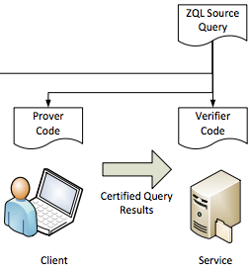
ZQL
42
Target code is purely-functional, operates on F# lists
Translated code mimics structure of original program, does additional cryptographic work for each primitive operation
Relies heavily on a few primitive operations: map, fold, find
Lambdas allowed only in limited contexts
Translated code is highly parallelizable, esp. for the prover
Runtime available for WP 7 and 8

Slide 43
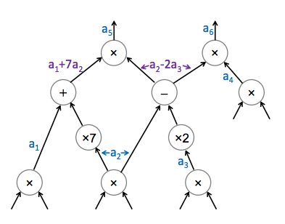
Pinocchio
Target code is a fixed-length arithmetic circuit
Input language is C with static loops, constant dereferences, no recursion
Everything is in-lined
Values are broken into constituent bits, Boolean operations used
Circuit evaluator/prover is optimized native code
Requires polynomial interpolation and division
No support for parallel execution
Notes:
Outline:
Continue explaining why such a dramatic performance discrepancy exists
Discuss Pinocchio
Discuss its object code execution model
Briefly discuss how it translates a functional program into prover, and verifier

Slide 44
Goals for ZØ
Performance
Usability
Neither back-end is one-size-fits-all
Understanding performance requires specialized knowledge
Bring zero-knowledge to “the masses”
Users should never write their own crypto
Seamless integration with existing code
  LINQ is our bridge to zero-knowledge
  Can integrate ZK with large amounts of UI, Libraries, arbitrary logic
Automates tier-splitting

Slide 45
ZØ: An Optimizing Compiler for ZK
45
Input
Performance Analysis
ZK Translation
Tier Splitting
  C# Source
  Cost Polynomial
  Arithmetic Circuit
  .NET IL
Client IL
Server IL
Resource IL
Implemented in C# and F#
  9995 LoC
  Uses CCI for processing and analysis, operates on IL
  Uses Solver Foundation to resolve constraints
Still a work in progress
  Integrate cost model generator
  Tune cost model primitive coefficients

Slide 46

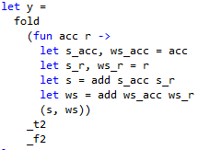
Translation in Action
46
ZQL
Pinocchio
1 Multiplication
100 Additions
101 I/O Wires
total 203
input 0 # input
input 1 # input
input 2 # input
input 3 # input
input 4 # input
input 5 # input
input 6 # input
input 7 # input
input 8 # input
input 9 # input
input 10# input
input 11# input
input 12# input
input 13# input
input 14# input
input 15# input
input 16# input
input 17# input
input 18# input
input 19# input
input 20# input
input 21# input
input 22# input
input 23# input
input 24# input
input 25# input
input 26# input
input 27# input
input 28# input
input 29# input
input 30# input
input 31# input
input 32# input
input 33# input
input 34# input
input 35# input
input 36# input
input 37# input
input 38# input
input 39# input
input 40# input
input 41# input
input 42# input
input 43# input
input 44# input
input 45# input
input 46# input
input 47# input
input 48# input
input 49# input
input 50# input
input 51# input
input 52# input
input 53# input
input 54# input
input 55# input
input 56# input
input 57# input
input 58# input
input 59# input
input 60# input
input 61# input
input 62# input
input 63# input
input 64# input
input 65# input
input 66# input
input 67# input
input 68# input
input 69# input
input 70# input
input 71# input
input 72# input
input 73# input
input 74# input
input 75# input
input 76# input
input 77# input
input 78# input
input 79# input
input 80# input
input 81# input
input 82# input
input 83# input
input 84# input
input 85# input
input 86# input
input 87# input
input 88# input
input 89# input
input 90# input
input 91# input
input 92# input
input 93# input
input 94# input
input 95# input
input 96# input
input 97# input
input 98# input
input 99# input
input 100 # input (unused)
input 101 # one-input
const-mul-0 in 1 <101> out 1 <102># zero
add in 2 <0 1> out 1 <103> # add
add in 2 <103 2> out 1 <104> # add
add in 2 <104 3> out 1 <105> # add
add in 2 <105 4> out 1 <106> # add
add in 2 <106 5> out 1 <107> # add
add in 2 <107 6> out 1 <108> # add
add in 2 <108 7> out 1 <109> # add
add in 2 <109 8> out 1 <110> # add
add in 2 <110 9> out 1 <111> # add
add in 2 <111 10> out 1 <112> # add
add in 2 <112 11> out 1 <113> # add
add in 2 <113 12> out 1 <114> # add
add in 2 <114 13> out 1 <115> # add
add in 2 <115 14> out 1 <116> # add
add in 2 <116 15> out 1 <117> # add
add in 2 <117 16> out 1 <118> # add
add in 2 <118 17> out 1 <119> # add
add in 2 <119 18> out 1 <120> # add
add in 2 <120 19> out 1 <121> # add
add in 2 <121 20> out 1 <122> # add
add in 2 <122 21> out 1 <123> # add
add in 2 <123 22> out 1 <124> # add
add in 2 <124 23> out 1 <125> # add
add in 2 <125 24> out 1 <126> # add
add in 2 <126 25> out 1 <127> # add
add in 2 <127 26> out 1 <128> # add
add in 2 <128 27> out 1 <129> # add
add in 2 <129 28> out 1 <130> # add
add in 2 <130 29> out 1 <131> # add
add in 2 <131 30> out 1 <132> # add
add in 2 <132 31> out 1 <133> # add
add in 2 <133 32> out 1 <134> # add
add in 2 <134 33> out 1 <135> # add
add in 2 <135 34> out 1 <136> # add
add in 2 <136 35> out 1 <137> # add
add in 2 <137 36> out 1 <138> # add
add in 2 <138 37> out 1 <139> # add
add in 2 <139 38> out 1 <140> # add
add in 2 <140 39> out 1 <141> # add
add in 2 <141 40> out 1 <142> # add
add in 2 <142 41> out 1 <143> # add
add in 2 <143 42> out 1 <144> # add
add in 2 <144 43> out 1 <145> # add
add in 2 <145 44> out 1 <146> # add
add in 2 <146 45> out 1 <147> # add
add in 2 <147 46> out 1 <148> # add
add in 2 <148 47> out 1 <149> # add
add in 2 <149 48> out 1 <150> # add
add in 2 <150 49> out 1 <151> # add
add in 2 <151 50> out 1 <152> # add
add in 2 <152 51> out 1 <153> # add
add in 2 <153 52> out 1 <154> # add
add in 2 <154 53> out 1 <155> # add
add in 2 <155 54> out 1 <156> # add
add in 2 <156 55> out 1 <157> # add
add in 2 <157 56> out 1 <158> # add
add in 2 <158 57> out 1 <159> # add
add in 2 <159 58> out 1 <160> # add
add in 2 <160 59> out 1 <161> # add
add in 2 <161 60> out 1 <162> # add
add in 2 <162 61> out 1 <163> # add
add in 2 <163 62> out 1 <164> # add
add in 2 <164 63> out 1 <165> # add
add in 2 <165 64> out 1 <166> # add
add in 2 <166 65> out 1 <167> # add
add in 2 <167 66> out 1 <168> # add
add in 2 <168 67> out 1 <169> # add
add in 2 <169 68> out 1 <170> # add
add in 2 <170 69> out 1 <171> # add
add in 2 <171 70> out 1 <172> # add
add in 2 <172 71> out 1 <173> # add
add in 2 <173 72> out 1 <174> # add
add in 2 <174 73> out 1 <175> # add
add in 2 <175 74> out 1 <176> # add
add in 2 <176 75> out 1 <177> # add
add in 2 <177 76> out 1 <178> # add
add in 2 <178 77> out 1 <179> # add
add in 2 <179 78> out 1 <180> # add
add in 2 <180 79> out 1 <181> # add
add in 2 <181 80> out 1 <182> # add
add in 2 <182 81> out 1 <183> # add
add in 2 <183 82> out 1 <184> # add
add in 2 <184 83> out 1 <185> # add
add in 2 <185 84> out 1 <186> # add
add in 2 <186 85> out 1 <187> # add
add in 2 <187 86> out 1 <188> # add
add in 2 <188 87> out 1 <189> # add
add in 2 <189 88> out 1 <190> # add
add in 2 <190 89> out 1 <191> # add
add in 2 <191 90> out 1 <192> # add
add in 2 <192 91> out 1 <193> # add
add in 2 <193 92> out 1 <194> # add
add in 2 <194 93> out 1 <195> # add
add in 2 <195 94> out 1 <196> # add
add in 2 <196 95> out 1 <197> # add
add in 2 <197 96> out 1 <198> # add
add in 2 <198 97> out 1 <199> # add
add in 2 <199 98> out 1 <200> # add
add in 2 <200 99> out 1 <201> # add
mul in 2 <101 201> out 1 <202># output-cast
output 202 #

Slide 47
Performance Comparison
47
Tables
Requires fixed input size
All operations execute over every element
Uses functional lists
Find operations complete when predicate matched
Comparisons
Built-in support for “standard” ops
Supports conditional expressions
Arithmetic
Fixed-width operations
Infinite-precision
Multiplication increases data size
Built-in support for equality*
Other comparisons must be implemented in query
Good for fixed-size arithmetic expressions
Good for complex comparisons
Good for fixed arithmetic
Pinocchio
Good for
“Big Data” operations
Good for “Big Data”
Good for more complex Boolean queries
ZQL

Slide 48
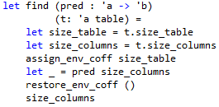
ZQL Performance
Symbolically execute code generated by ZQL compiler
Terms represent input size
Tracks iterations of current expression
Execute nested operation
Accumulate cost of nested op.
Cryptographic
Overhead
eqOp*regionListSize + addOP + 12*expOp + 3 * extendOp + 14*mltOp + …
Notes:
Outline:
Discuss performance models for ZQL applications
We build them by symbolically executing the F# code emitted by the ZQL compiler
Discuss the symbolic operations that are performed by a few of the more important primitive operations
Show an example portion of a query from Waze, and the output of the model builder

Slide 49
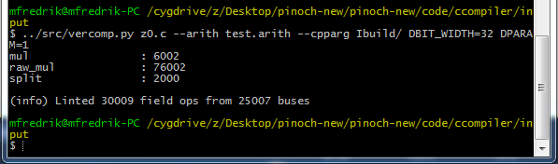
Pinocchio Performance
Static polynomial based on circuit characteristics
Interpolation Cost
# Multiplication Gates | d
# Input Wires | N
Proof Gen & Computation | (7(d + N) – 2N + d)ExpMulB + … + O(d log² d)(mul + add)
Verification | N(mul + add) + 7Pair
Source: Bryan Parno
O(6002 log² 6002)(add+mul) + 6507 ExpT + 44034 ExpB + 50541 ExpMulB + …
Notes:
Outline:
Discuss performance models for Pinocchio
Show how we build them: examine the structure of the circuit generated by the Pinocchio compiler
Show an example sub-query from Waze, and its translation into a circuit
Show the performance model constructed from this example

Slide 50
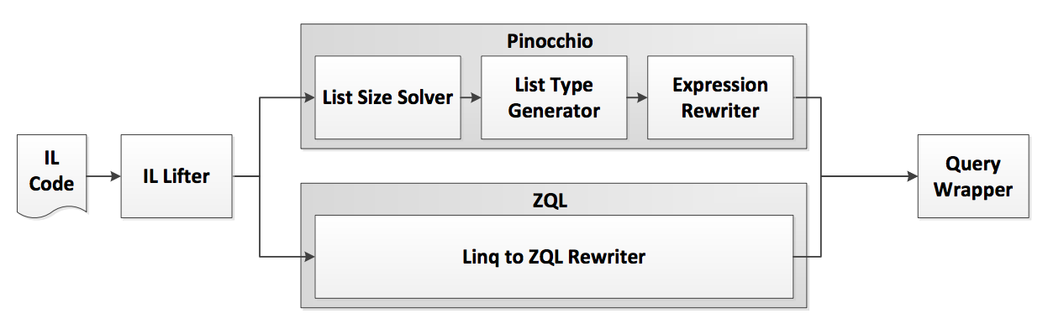

Compiling to Zero-Knowledge
Core LINQ expressions
Combinations of list-structured data
Notes:
Outline:
Begin discussing the translation from C# to zero-knowledge
Introduce the subset of C# that we can translate into zero-knowledge

Slide 51
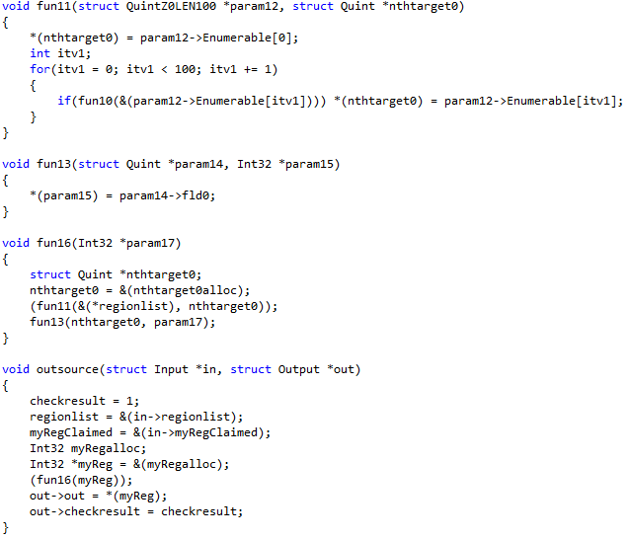
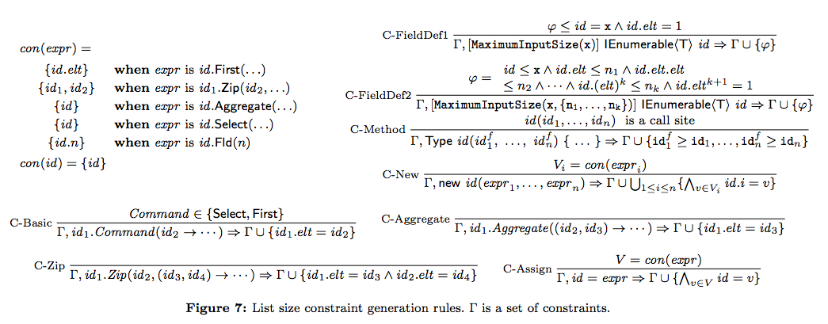
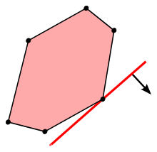




LINQ -> Pinocchio
1. Infer input sizes and list bounds
Size attributes
Linear Program
2. Create and assign types to expressions
bounds → | Tuple5
regions → | Tuple5100
3. Encapsulate each sub-expression in a distinct function
Notes:
Outline:
Discuss the translation of C# to Pinocchio
Go through each step, as discussed in the paper:
Solve for list sizes
Generate types and isolate expressions into functions
Show an example translation

Slide 52
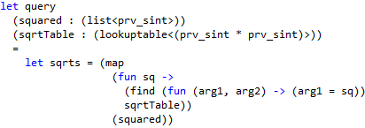

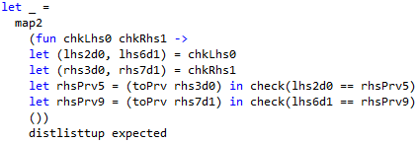
LINQ -> ZQL
1. Mostly straightforward translation from LINQ to F#
squared.Select
sqrtTable.First
Caveat: ZQL queries cannot output structured data
Fail proof checking when false
2. Generate output check
Descend on the structure of the output type, apply map and check
Pass result of LINQ operation to ZQL query
Notes:
Outline:
Discuss the translation of C# to ZQL
Go through each step:
Translate LINQ to basic F#
Generate a “result checker” expression, by descending on the types of the input and output, to compare the expected result to the result computed in the proof
(This is necessary because ZQL does not allow structured data outputs of zero-knowledge computations)
Show an example translation

Slide 53
53
< Demo >

Slide 54
Back to our example…
Z
Look up region in a large table of coordinates
P
Show that GPS coordinates match result
P
Encode region as a vector
ZP
Creates shares of vector
ZP
Sums other clients’ shares
Notes:
Draw connections back to the Waze app, showing example sub-operations that perform better in one or another backend

Slide 55

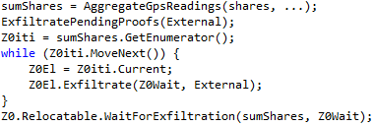
Distributing Across Tiers
Core Principle: Rely on runtime whenever possible
Minimize the role of the compiler:
  Infer dependencies between tiers
  Insert calls to runtime API whenever cross-tier dependencies exist
Only the main function can call code on multiple tiers
Functions called from main always return Enumerable
Each element inherits from “relocatable” type
Notes:
Outline:
Discuss the tier-splitting operation
Takeaway point: to simplify translation, hide most of the functionality in a runtime with a very simple API
Show an example translation from Waze

Slide 56
ZØ: An Optimizing Compiler for ZK
56
ZØ uses the best of both back-ends as appropriate for the application at hand
Input
Performance Analysis
ZK Translation
Tier Splitting
  C# Source
  Cost Model
  Arithmetic Circuit
  .NET IL
Client IL
Server IL
Resource IL
Notes:
Give an overview of how the compiler accomplishes its goals

Slide 57
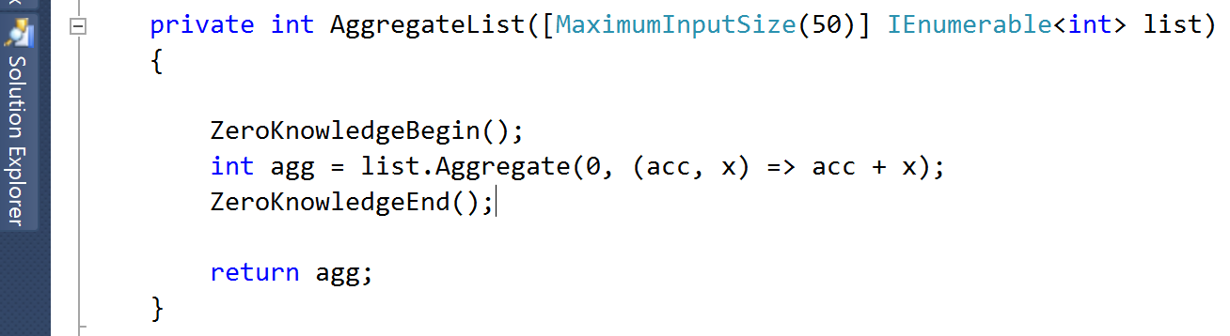
Translating C# To Zero-Knowledge
Specify ZK input sizes to help optimization
Programmers specify ZK regions
ZK operations given by LINQ expressions
Notes:
Give the main points of writing ZK code, using this example code snippet

